Slide 1


Assignment 1
Single Layer Perceptron
for Iris Binary
Classification
Muhammad Javier
{{NIM}}
Deep Learning — Universitas Gadjah Mada
Merakyat, Mandiri, Berkelanjutan
Inclusive, Self-Reliant, Sustainable
ugm.ac.id

Slide 2
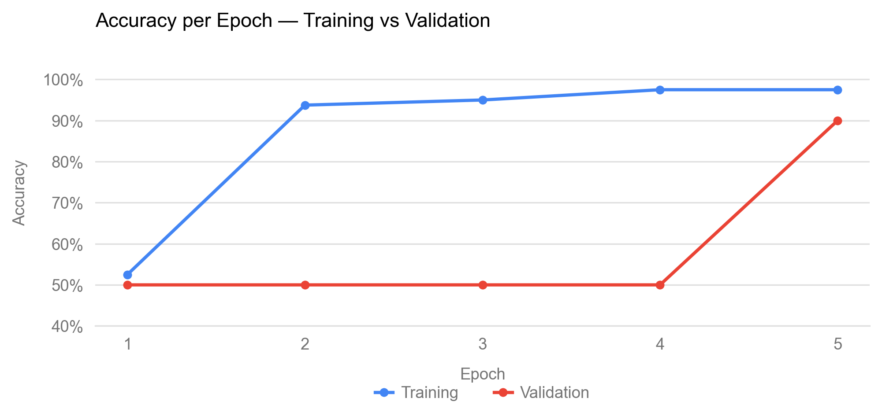
Accuracy — Google Sheets
Training vs validation accuracy per epoch, computed in the SLP spreadsheet (80 training / 20 validation samples).
Training accuracy rises 52.50% → 97.50%. Validation holds at 50.00% for four epochs, then jumps to 90.00% once the decision boundary crosses the held-out Versicolour samples.
2

Slide 3
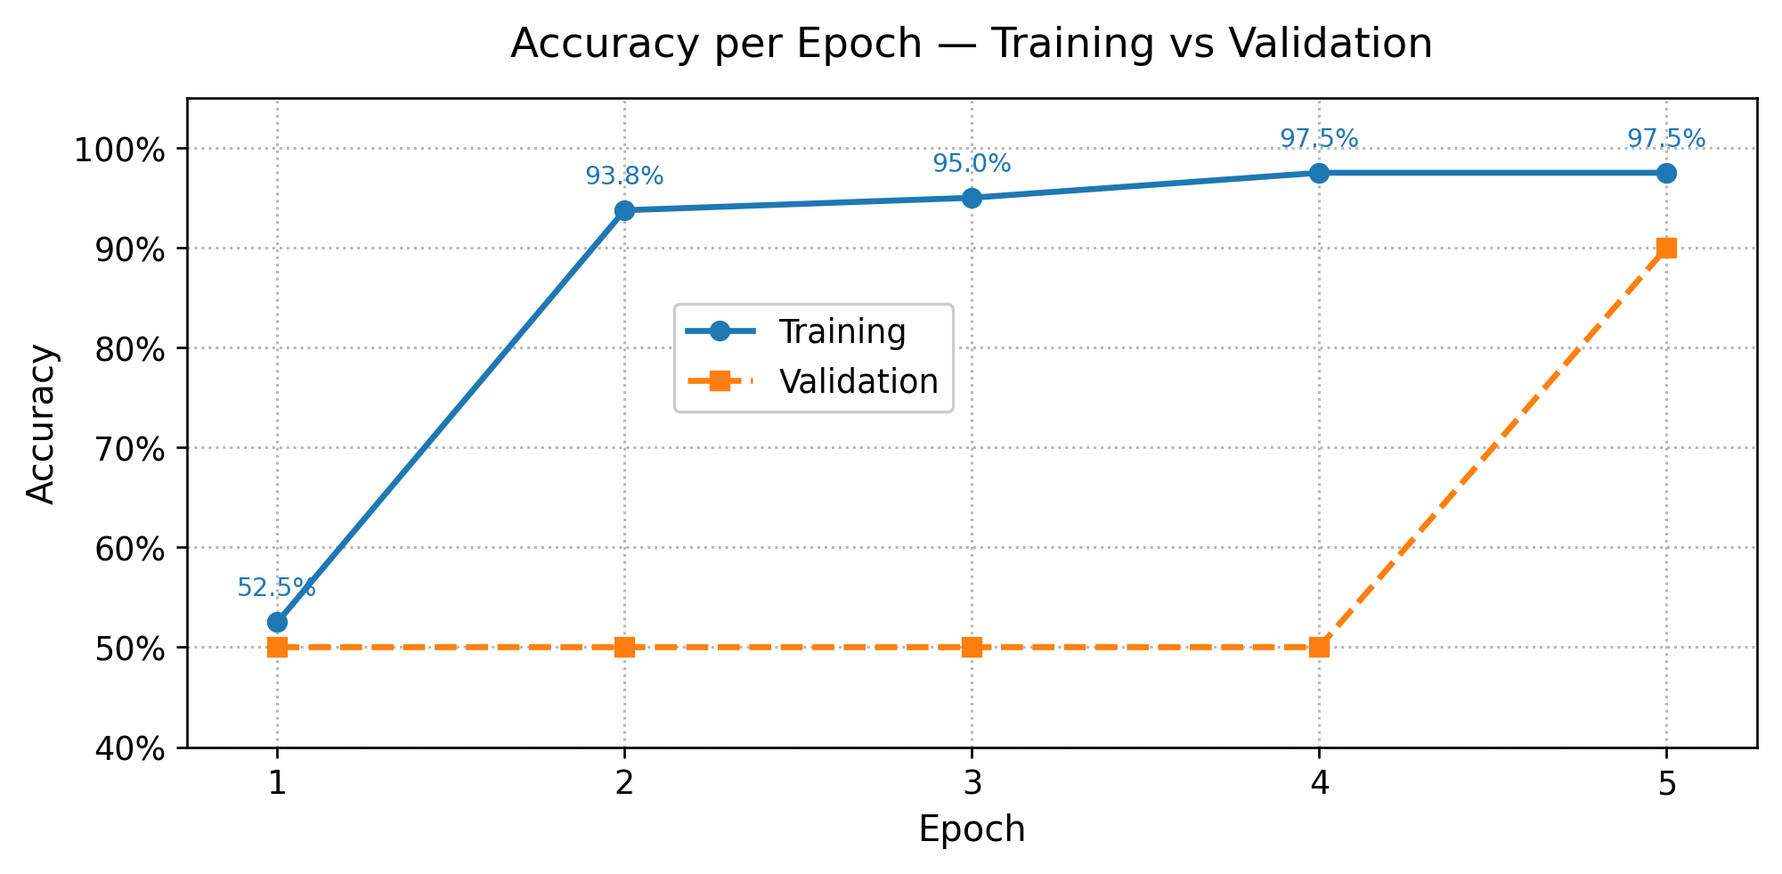
Accuracy — Python Implementation
The same run reproduced by SLP-python.py — identical initialisation, update rule and sample order.
Every epoch matches the spreadsheet exactly: 52.50%, 93.75%, 95.00%, 97.50%, 97.50% (training) and 50.00% ×4 then 90.00% (validation).
3

Slide 4
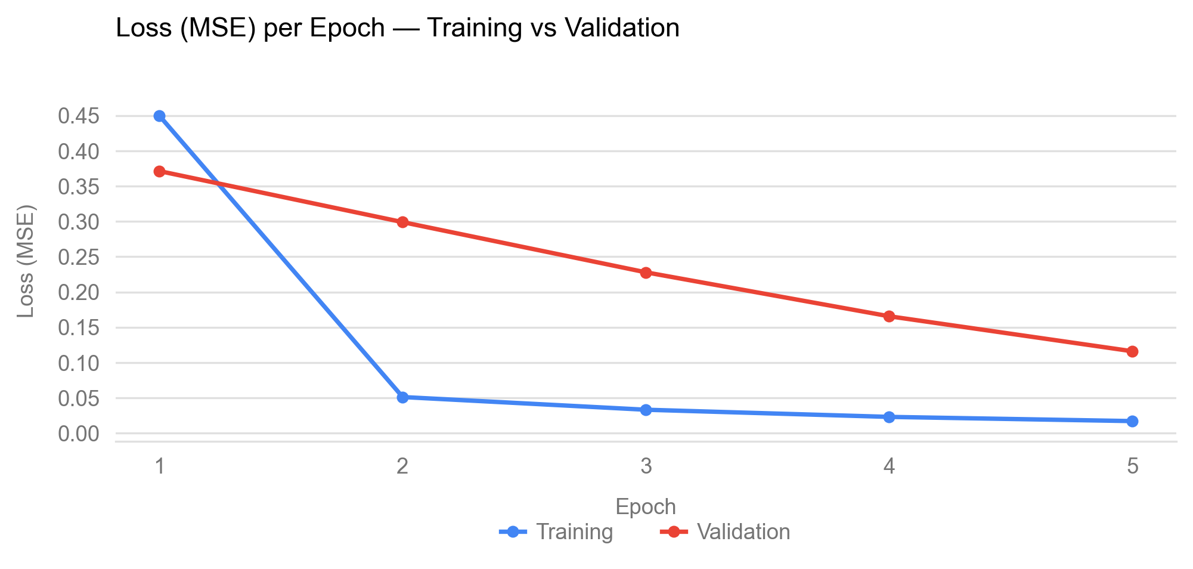
Loss (MSE) — Google Sheets
Mean Sum-Square-Error per epoch, averaged over each split in the spreadsheet.
Training loss falls 0.449439 → 0.017130, the steepest drop in epoch 2. Validation loss decreases steadily 0.371174 → 0.116033 — no divergence, so the model is not overfitting.
4

Slide 5
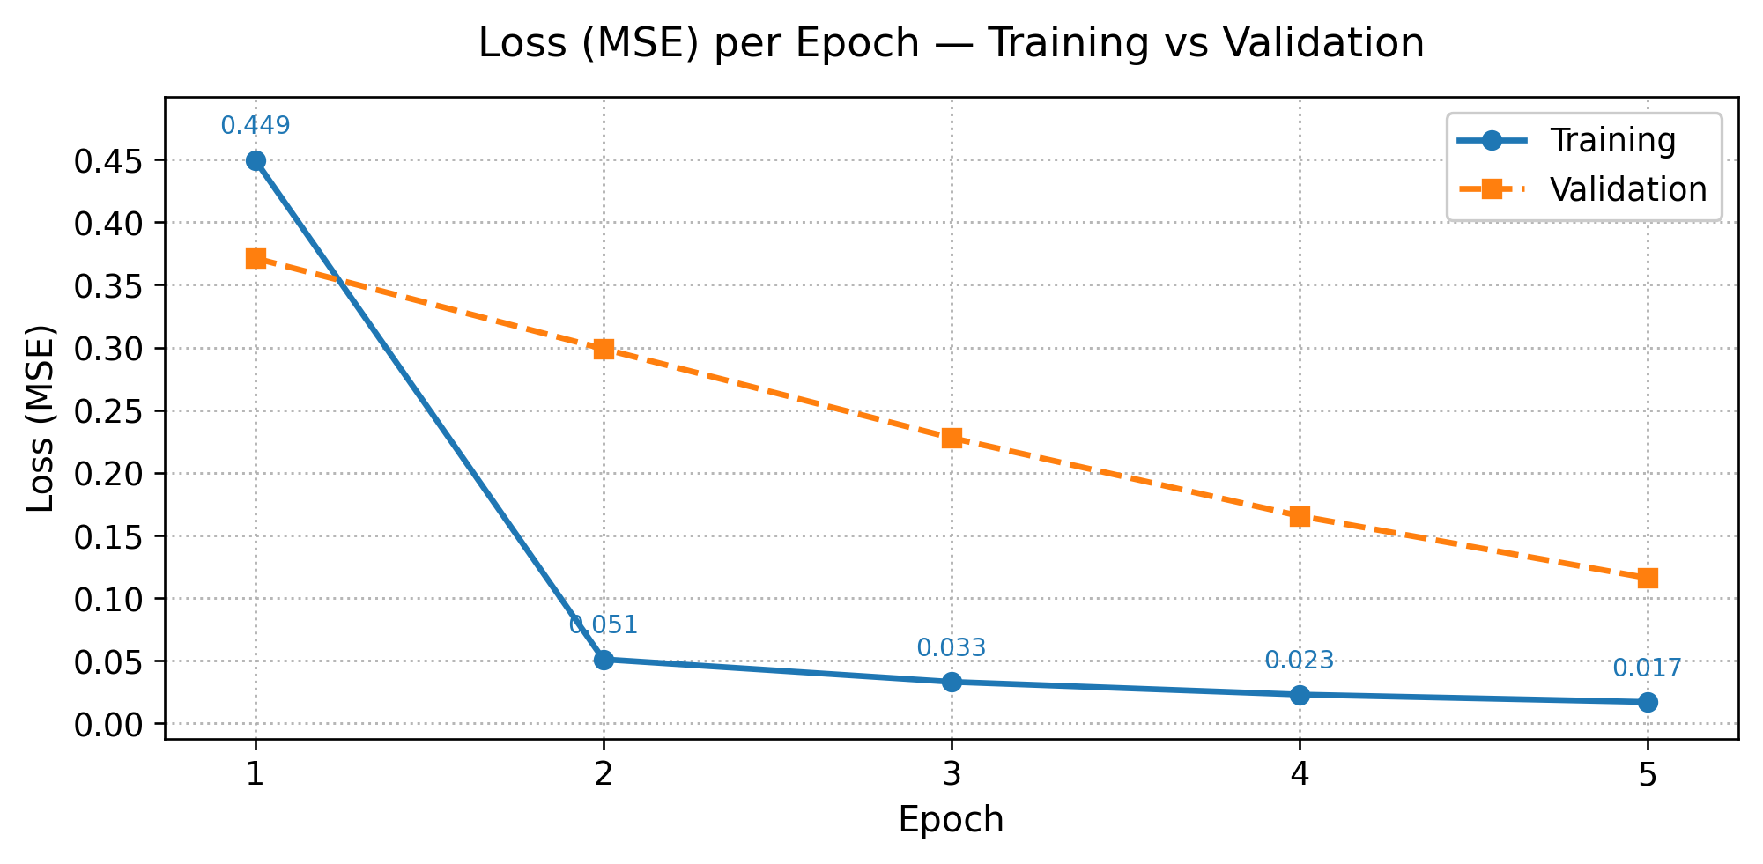
Loss (MSE) — Python Implementation
Loss curves produced by SLP-python.py for the same five epochs.
Training loss reproduces the spreadsheet's Sum-Square-Error column exactly — 0.4494387188, 0.0511854607, 0.0332093816, 0.0230762321, 0.0171304299 — confirming both implementations follow the same update rule.
5

Slide 6
Source Links
Spreadsheet and source code for Tasks 1 and 2.
01 Google Spreadsheet
Task 1 — SLP worksheet, 5 epochs, 80 training / 20 validation samples
https://docs.google.com/spreadsheets/d/1yhi8ASebpmljJ3NpYQ7NmxlWLmhGOI6W/edit?gid=1211907647#gid=1211907647
02 GitHub Repository
Task 2 — SLP-python.py, the Python implementation of the same model
{{GITHUB_REPO_URL}}
6

Slide 7
References
1.
Afiahayati. (2026). Linear Classifier — Single Layer Perceptron [Lecture slides]. Department of Computer Science and Electronics, Universitas Gadjah Mada.
2.
Rosenblatt, F. (1958). The perceptron: A probabilistic model for information storage and organization in the brain. Psychological Review, 65(6), 386–408.
3.
Fisher, R. A. (1936). The use of multiple measurements in taxonomic problems. Annals of Eugenics, 7(2), 179–188.
4.
Dua, D., & Graff, C. (2019). Iris Data Set. UCI Machine Learning Repository. https://archive.ics.uci.edu/dataset/53/iris
5.
UCI Machine Learning. (2016). Iris Species [Data set]. Kaggle. https://www.kaggle.com/datasets/uciml/iris
6.
Goodfellow, I., Bengio, Y., & Courville, A. (2016). Deep Learning. MIT Press.
7.
Harris, C. R., et al. (2020). Array programming with NumPy. Nature, 585, 357–362. · Hunter, J. D. (2007). Matplotlib: A 2D graphics environment. Computing in Science & Engineering, 9(3), 90–95.
7

